Slide 2
DNSSEC
made simple

Slide 3
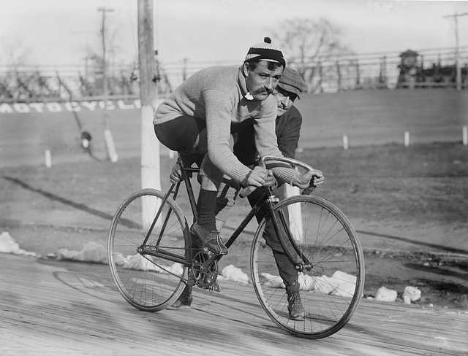
[e@ninj4v9 ~]$ whoami
Emil Natan, CTO, ISOC-IL

Slide 4
DNS

Slide 5
DNS
Authoritative
nameserver
(.)
Authoritative
nameserver
(com.)
Authoritative
nameserver
(il.)
Authoritative
nameserver
(isoc.org.il)
Resolver
home/company
Resolver
Public (8.8.8.8)
Resolver
ISP
STUB
(client)
STUB
(client)
STUB
(client)

Slide 6
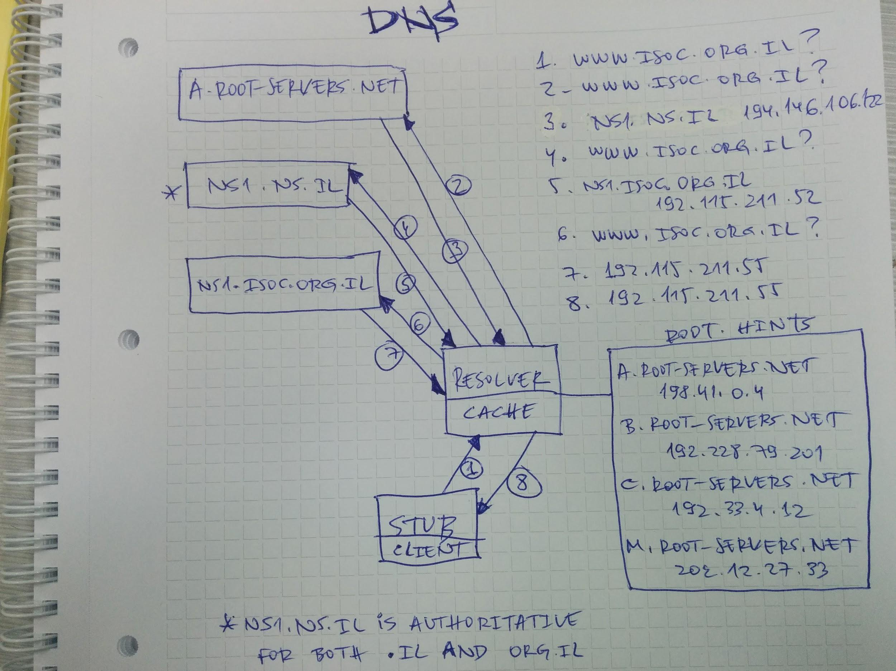

Slide 7
Delegation
org.il. SOA 2017102549 1800 900 3628800
NS nsa.ns.il. NS ns1.ns.il
NS ns2.ns.il. NS nsb.ns.il.
org.il zonefile
isoc.org.il. NS ns1.isoc.org.il. isoc.org.il. NS sns-pb.isc.org. isoc.org.il. NS ns3.isoc.org.il. isoc.org.il. NS aristo.tau.ac.il.
ns1.isoc.org.il. A 192.115.211.52 ns3.isoc.org.il. A 192.115.4.131
isoc.org.il. SOA 2017102500 21600 3600 2419200
isoc.org.il. MX 100 mx1.isoc.org.il. isoc.org.il. MX 200 mx2.isoc.org.il.
www.isoc.org.il. A 192.115.211.55
isoc.org.il. NS ns1.isoc.org.il. isoc.org.il. NS sns-pb.isc.org. isoc.org.il. NS ns3.isoc.org.il. isoc.org.il. NS aristo.tau.ac.il.
ns1.isoc.org.il. A 192.115.211.52 ns3.isoc.org.il. A 192.115.4.131
Delegation
Information
isoc.org.il zonefile
Notes:
Delegation information is passed over non-DNS channel

Slide 8
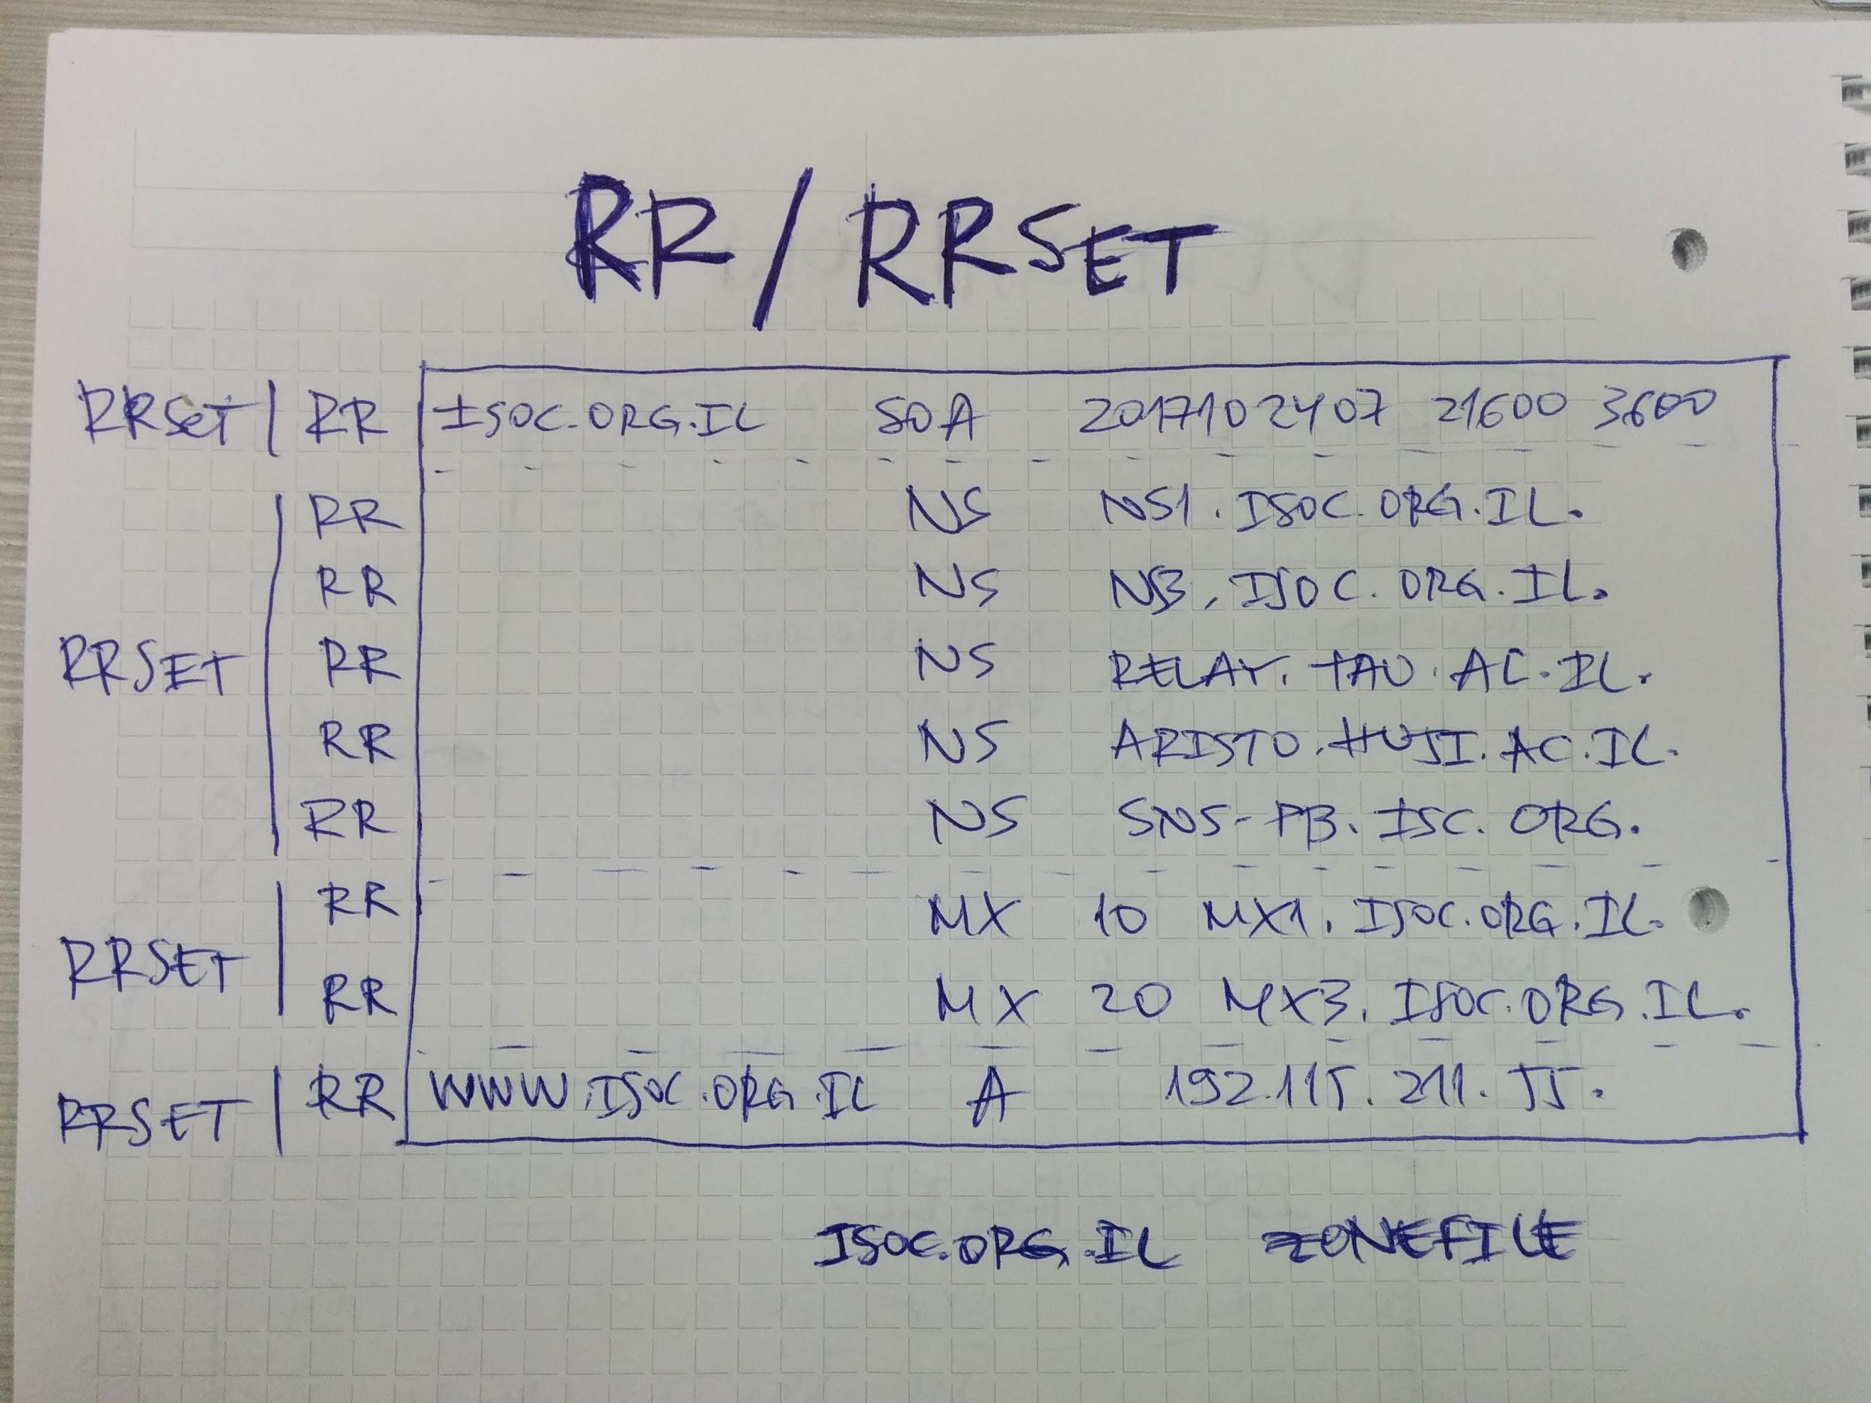

Slide 9
PKI (Digital signing)
Digital Signing (!= Encryption)
Authentication (authenticate the signer)
Integrity
Digital signatures employ asymmetric cryptography.
A digital signature scheme typically consists of 3 algorithms:
Key generation algorithm
Signing algorithm
Signature verifying algorithm
Notes:
A key generation algorithm. The algorithm outputs the private key and a corresponding public key.
A signing algorithm that, given a message and a private key, produces a signature.
A signature verifying algorithm that, given the message, public key and signature, either accepts or rejects the message's claim to authenticity.
The authenticity of a signature generated from a fixed message and fixed private key can be verified by using the corresponding public key

Slide 10
Why DNSSEC
DNS spoofing
question section
+
transaction ID
+
Source address
+
Destination address + destination port
DNSSEC protects your clients
DNSSEC vs. HTTPS
Redirect to attackers server which forces insecure HTTP
SSL certificate validation relies on DNS validation (email, file on webserver)
Non Web resources
Single trust authority vs. thousands
Makes DNS safer environment for DKIM, DANE, CAA
Notes:
Extended Validation (EV)
DNS-based Authentication of Named Entities (DANE)
DNS Certification Authority Authorization (CAA)

Slide 11
DNSSEC
DNSSEC uses public key cryptography to sign and authenticate DNS resource record sets (RRsets).
A zone signs its authoritative RRsets by using a private key and stores the corresponding public key in a DNSKEY RR.
A resolver uses the public key to validate signatures covering the RRsets and thus to authenticate them.

Slide 12
DNSSEC
SOA
A
SOA
A
DNSSEC
RRSIG
RRSIG
AAAA
AAAA
NS
NS
NS
NS
NS
NS
NS
NS
RRSIG
MX
MX
RRSIG
MX
MX
RRSIG
Unsigned zonefile
Signed zonefile

Slide 13
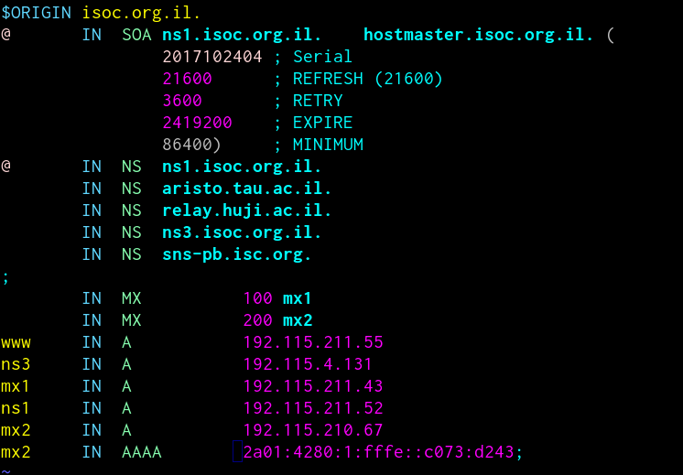

Slide 14
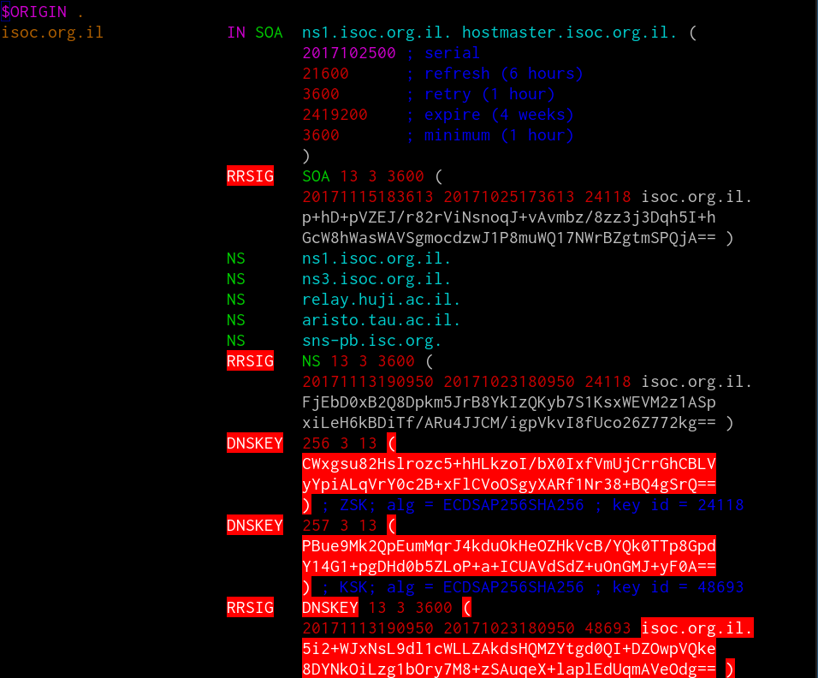

Slide 15
DNSSEC
The first time I’m confronted with DNSSEC

Slide 16
What’s new
New record types:
DNSKEY
RRSIG
NSEC/NSEC3 + NSEC3PARAM
DS
New flags:
AD
CD
DO (extended flag, requires EDNS)
EDNS

Slide 17
What’s new
DS
Parent zonefile
DNSKEY
RRSIG
NSEC/NSEC3
Child zonefile
DO
CD
Request
AD
Response
EDNS

Slide 18
DNSKEY, RRSIG, DS
isoc.org.il. 3600 IN DNSKEY 257 3 13 PBue9Mk2QpEumMqrJ4kduOkHeOZHkVcB/YQk0TTp8GpdY14G1+pgDHd0 b5ZLoP+a+ICUAVdSdZ+uOnGMJ+yF0A== isoc.org.il. 3600 IN DNSKEY 256 3 13 CWxgsu82Hslrozc5+hHLkzoI/bX0IxfVmUjCrrGhCBLVyYpiALqVrY0c 2B+xFlCVoOSgyXARf1Nr38+BQ4gSrQ==
isoc.org.il. 3600 IN RRSIG DNSKEY 13 3 3600 20171113190950 20171023180950 48693 isoc.org.il. 5i2+WJxNsL9dl1cWLLZAkdsHQMZYtgd0QI+DZOwpVQke8DYNkOiLzg1b Ory7M8+zSAuqeX+laplEdUqmAVeOdg==
isoc.org.il. 4977 IN DS 48693 13 2 941C5E5CBDA733BED4E2DE3AB453AC5D789A9205281A6F8A706FA99D 83B10DE5

Slide 19
Delegation
org.il. SOA 2017102549 1800 900 3628800
NS nsa.ns.il. NS ns1.ns.il NS nsb.ns.il.
isoc.org.il. DS 48693 13 2 941C5E5...83B10DE5
isoc.org.il. NS ns1.isoc.org.il. isoc.org.il. NS sns-pb.isc.org. isoc.org.il. NS ns3.isoc.org.il. isoc.org.il. NS aristo.tau.ac.il.
ns1.isoc.org.il. A 192.115.211.52 ns3.isoc.org.il. A 192.115.4.131
isoc.org.il. SOA 2017102500 21600 3600 2419200
isoc.org.il. DNSKEY 257 3 13 PBue9Mk2Q...MJ+yF0A== isoc.org.il. DNSKEY 256 3 13 CWxgsu82H...BQ4gSrQ==
Isoc.org.il RRSIG DNSKEY 13 3 3600 20171113190...
isoc.org.il. NS ns1.isoc.org.il. isoc.org.il. NS sns-pb.isc.org. isoc.org.il. NS ns3.isoc.org.il. isoc.org.il. NS aristo.tau.ac.il.
ns1.isoc.org.il. A 192.115.211.52 ns3.isoc.org.il. A 192.115.4.131
Delegation
Information
Notes:
Delegation information is passed over non-DNS channel

Slide 20
Chain of Trust
Root zone
. DNSKEY
il. DS
il. RRSIG DS
Validate DNSKEY .
Resolver
Trusted Key (.)
Validate DS il.
Validate DNSKEY il.
il. zone
il. DNSKEY
org.il. DS
org.il. RRSIG DS
Validate DS org.il.
Validate DNSKEY isoc.org.il.
Validate A www.isoc.org.il.
Validate DNSKEY org.il.
Validate DS isoc.org.il.
org.il. zone
org.il. DNSKEY
isoc.org.il. DS
isoc.org.il. RRSIG DS
isoc.org.il. zone
isoc.org.il. DNSKEY
www.isoc.org.il A
www.isoc.org.il RRSIG A

Slide 21
Signing Keys
KSK:
Used to sign the DNSKEY record
Message digest of the KSK is used as part of the DS record (at the parent)
Rollover of KSK requires interaction with the parent domain
Longer
ZSK:
Used to sign other records in the zonefile
Rollover does not require interaction with the parent domain
Can be done frequently - shorter key

Slide 22
(DNSSEC =) Amplification
DNS amplification (and reflection) attacks existed well before DNSSEC
UDP lacks source address validation
meta-QTYPE ANY or specially crafted TXT RRs
Response Rate Limit (RRL)
DNS Cookies
ECDSA (Elliptic Curve Digital Signature Algorithm) - reduce size of keys and signatures

Slide 23
Zone enumeration
NSEC
NSEC3
DNSSEC white lies
NSEC5
For Registries it is a matter of policy
Instead of holding sensetive information in publicly accessible zone, use views

Slide 24
Last mile problem
Resolver performs validation, client trusts the resolver. Resolver is usually in the client’s network (ISP, University, Company)
Browser plugins
Linux, systemd-resolved performs caching and validation
DNScrypt - authenticates communications between a DNS client and a DNS resolver

Slide 25
“Resolvers must feel sad, nobody calls them by their name."

Slide 26
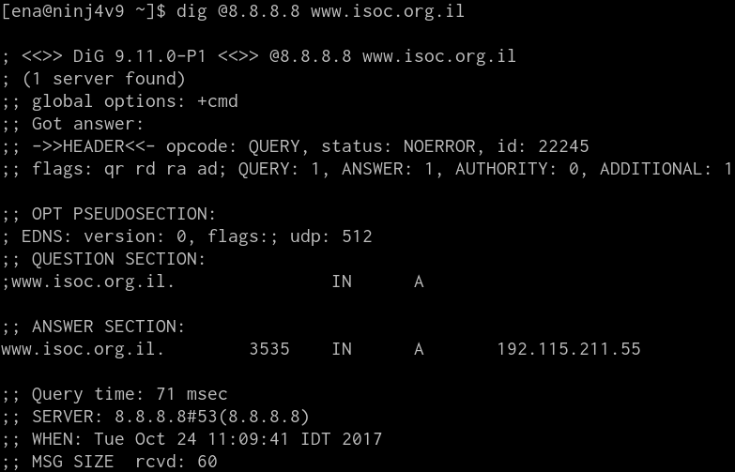
Does my resolver support DNSSEC

Slide 27
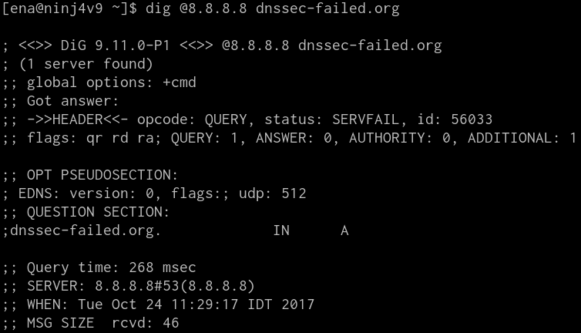
Does my resolver support DNSSEC

Slide 28
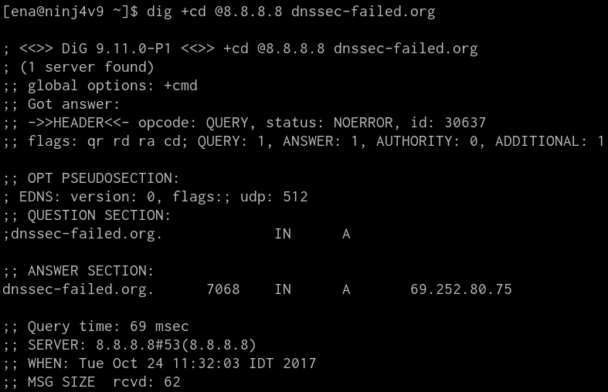
Does my resolver support DNSSEC

Slide 29
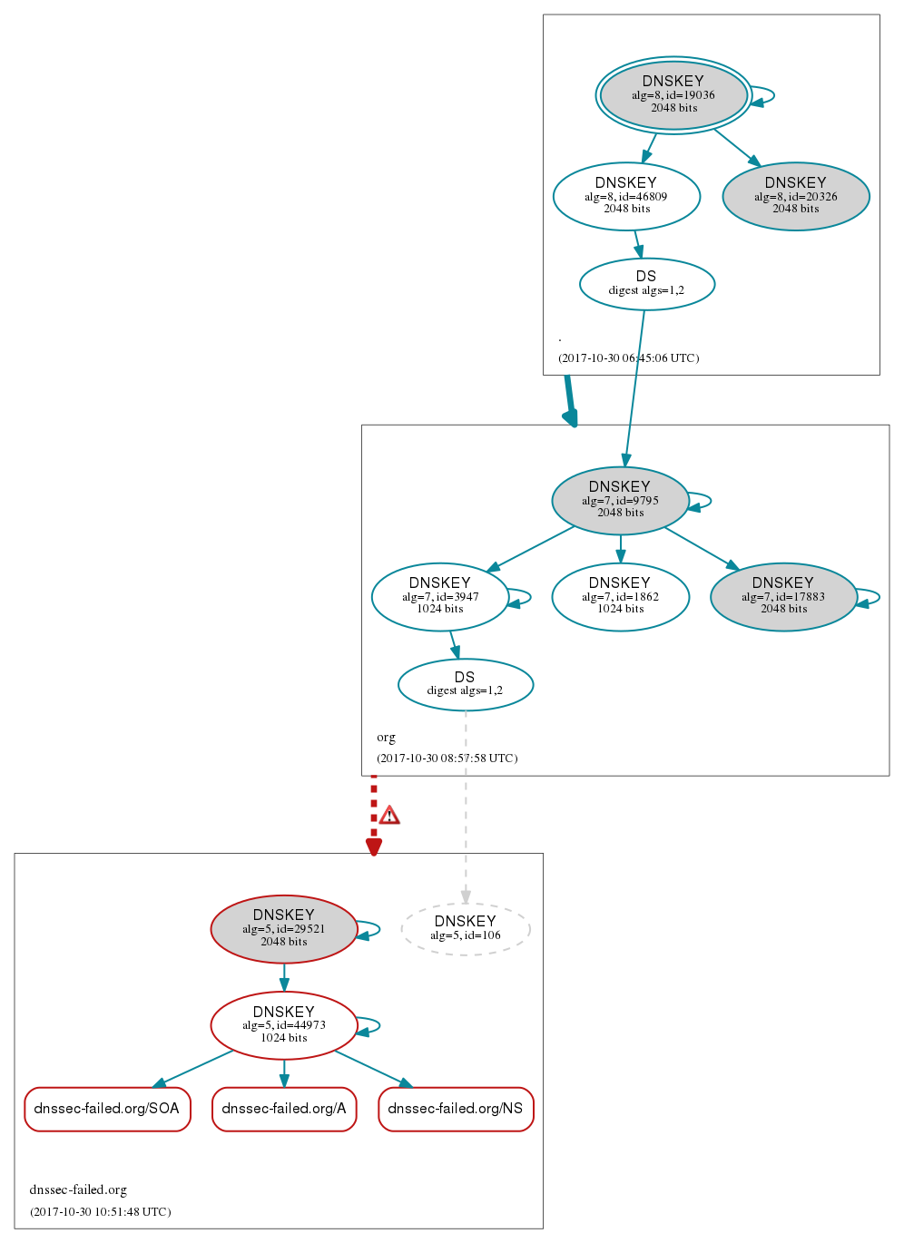
http://dnsviz.net/

Slide 30
DNSSEC at Resolver
Linux (BIND)
dnssec-enable yes; // Default
dnssec-validation yes;
trusted-keys
managed-keys
DNSSEC Validation the Easy Way (ISC KB: AA-01182)
Problem: You want your recursive BIND server to perform DNSSEC validation, but you don't have much time to invest.
Solution: options { ... dnssec-validation auto; ... };
rndc reconfig
Windows (Security-aware client)
Operating systems that are DNSSEC aware can be configured to require DNSSEC validation.
Windows 7, Windows Server 2008 R2, Windows 8, Windows Server 2012, and later operating systems are Security-aware.

Slide 31
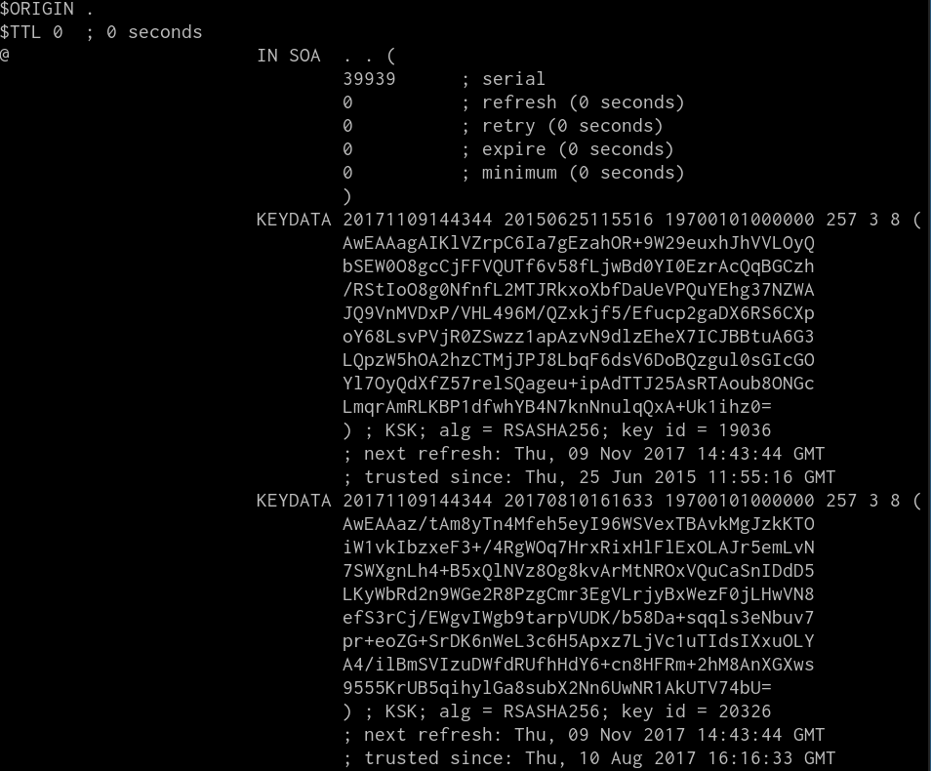

Slide 32
DNSSEC Resolver
Public resolvers
Validating: GPDNS (8.8.8.8, 8.8.4.4), UltraDNS (156.154.71.1, 156.154.70.1), Dyn (216.146.35.35, 216.146.36.36)
Non-validating: OpenDNS (208.67.220.220, 208.67.222.222), Level3 (4.2.2.2, 4.2.2.1)
Resolvers at Israeli ISPs
Performance penalty
End clients and DNSSEC - (they complain to the wrong party when something does not work because of broken DNSSEC)
Mix of validating and non-validating resolvers
Client behavior is application dependent (dig only queries the first resolver and does not retry if the validation fails, ping tries the second resolver if the first returns SERVFAIL). No added value.
Oct 11th
Notes:
High performance penalty that is incurred when a domain name is signed, but when DNSSEC validation cannot validate the signature. the name resolution process then starts a process of launching the query to other DNS resolvers to see if they can resolve the name. In this case the search for a successful resolution can take a significant amount of time

Slide 33
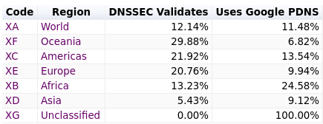
DNSSEC validation stats
0.024417455630603564 % failed
source: https://stats.labs.apnic.net/dnssec

Slide 34
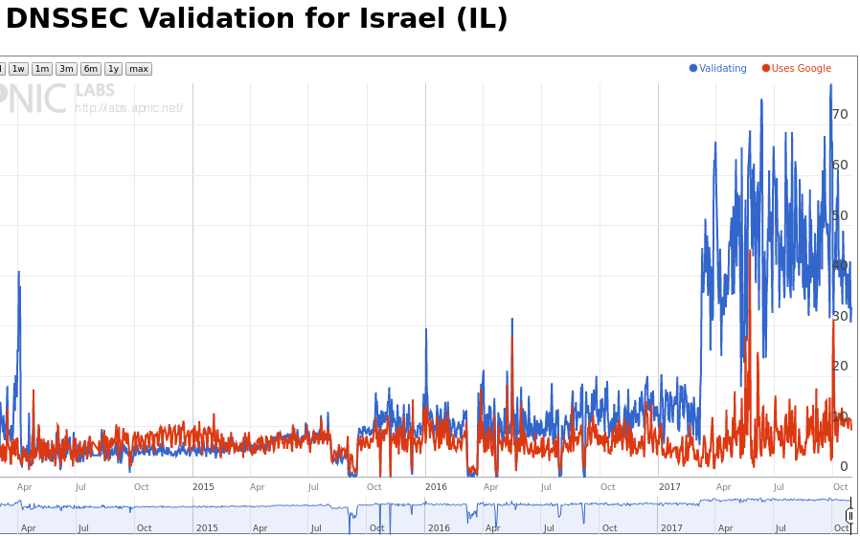
DNSSEC validation stats
source: https://stats.labs.apnic.net/dnssec

Slide 35
Implementing DNSSEC
(Homegrown signing stacks with full key roll support)

Slide 36
Signing and resigning
Signatures expiration
il. 8386 IN RRSIG SOA 8 1 86400 20170117220201 20161217210201 30780 il. wYa9DEmpNI4+7Yse012411pr2iM9qLsHvkpBfnA1wsvvBjVzbKau02Tk ...==
Through signature validity period, time in DNS becomes absolute (time dependent)
Until you feel the process is robust, resign often, leave longer signature validity period (3-4 weeks)
Check constantly - pre and after publishing
Do frequently

Slide 37
Key rollover
Why key rollover
Compromise of existing key(s)
Management policy (security and operational reasons)
Algorithm/key length change
HSM failure/ unrecoverable keys
Written procedures in place
Caching makes the process complicated
“Offline” DS update
Propagation delay
Going Insecure
Algorithm rollovers

Slide 38
Implementing DNSSEC
dnssec-keygen to generate keys
Zone configuration (named.conf)
Master
+
Signer
Signed zonefiles
Slaves
zone "isoc-il.net" { type master; file "isoc-il.net.zone"; allow-update { none; }; key-directory "/var/keys/isoc-il.net"; inline-signing yes; dnssec-dnskey-kskonly yes; serial-update-method date; auto-dnssec maintain; };

Slide 39
Implementing DNSSEC
“Offline signer”
“Bump in the wire” (good for existing environments)
External DNS service provider - EasyDNS, NameCheap, name.com, Rage4, Gandi, Dyn, UltraDNS, Hover, no-ip.com, dnsimple (and others) support DNSSEC
DNSSEC support at the Registrar
Signer
Signed zonefiles
Master
Signed zonefiles
Slaves
Master
Signed zonefiles
Signer
Signed zonefiles
Slaves

Slide 40
Picking a Signer
Command line tools
bind-tools, ldns
manual/(scripts + cronjobs) automation for resigning and key rollovers
“Batteries included”
Automated and effective resigning and key management
Open source: BIND, OpenDNSSEC, PowerDNS
Commercial products: Infoblox, Secure64
Key material management
HSM - PKCS#11, SoftHSM
Files stored on disk/removable storage

Slide 41
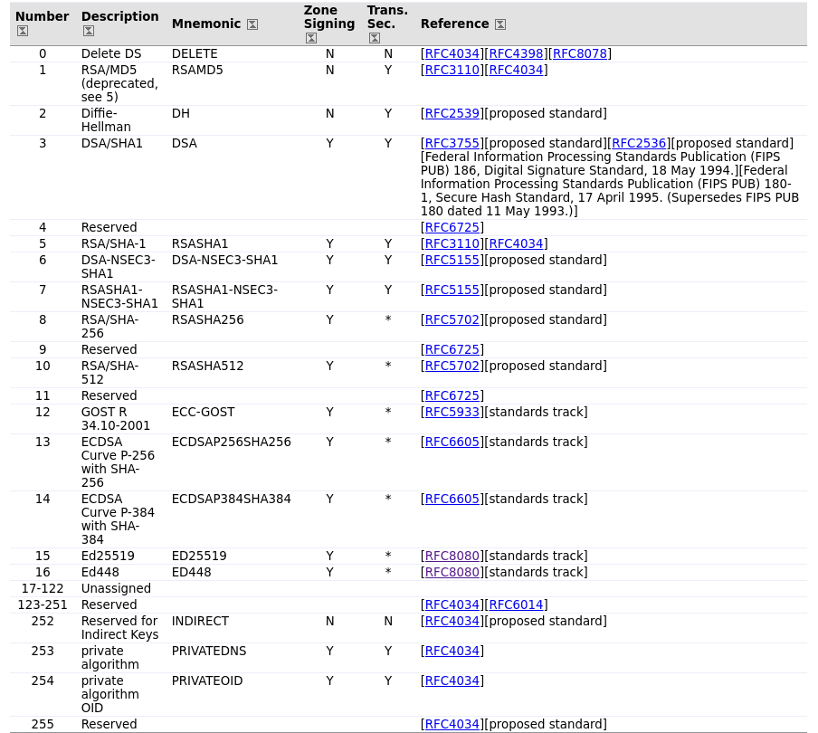
Algorithms, response size, validation
Source: https://www.iana.org/assignments/dns-sec-alg-numbers/dns-sec-alg-numbers.xhtml

Slide 42
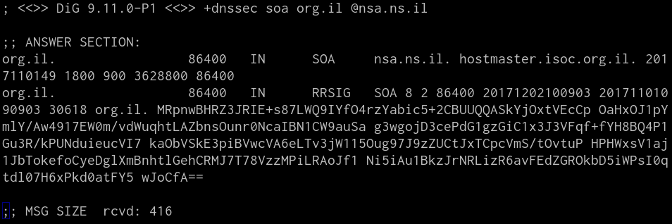
Algorithms, response size, validation

Slide 43
Algorithms, response size, validation

Slide 44
Implementation tips
Gradual implementation
Test environment with local root zone, TLD, resolver configured to use the local authoritative servers
Test with a signed zone with full path trusted chain
Test all slaves
Test network
Sign, but not publish DS, use trusted key
Publish DS
Backup keys (DB, keydb)

Slide 45
Monitoring DNSSEC
Pre-publication checks
Signatures validation (one or more tools)
Signatures expiry
Chain of trust with parent
Signed vs Unsigned
ODS vs BIND (signing)
Post-publication checks
Real validating resolver check
Signatures expiry
SOA between all authoritative nameservers
Debugging problems
{dig, drill} tools
DNSviz (http://dnsviz.net)
Zonemaster (https://www.zonemaster.net/)
DNSSEC Analyzer (https://dnssec-debugger.verisignlabs.com/)

Slide 46
What the future holds?
CDNSKEY, CDS (automating delegation)
DANE, CAA, etc
Validating STUB resolvers
Secure the last mile (DNS over TLS)

Slide 47
“The best thing about DNSSEC jokes is that you can check if they were told wrong.”

Slide 48
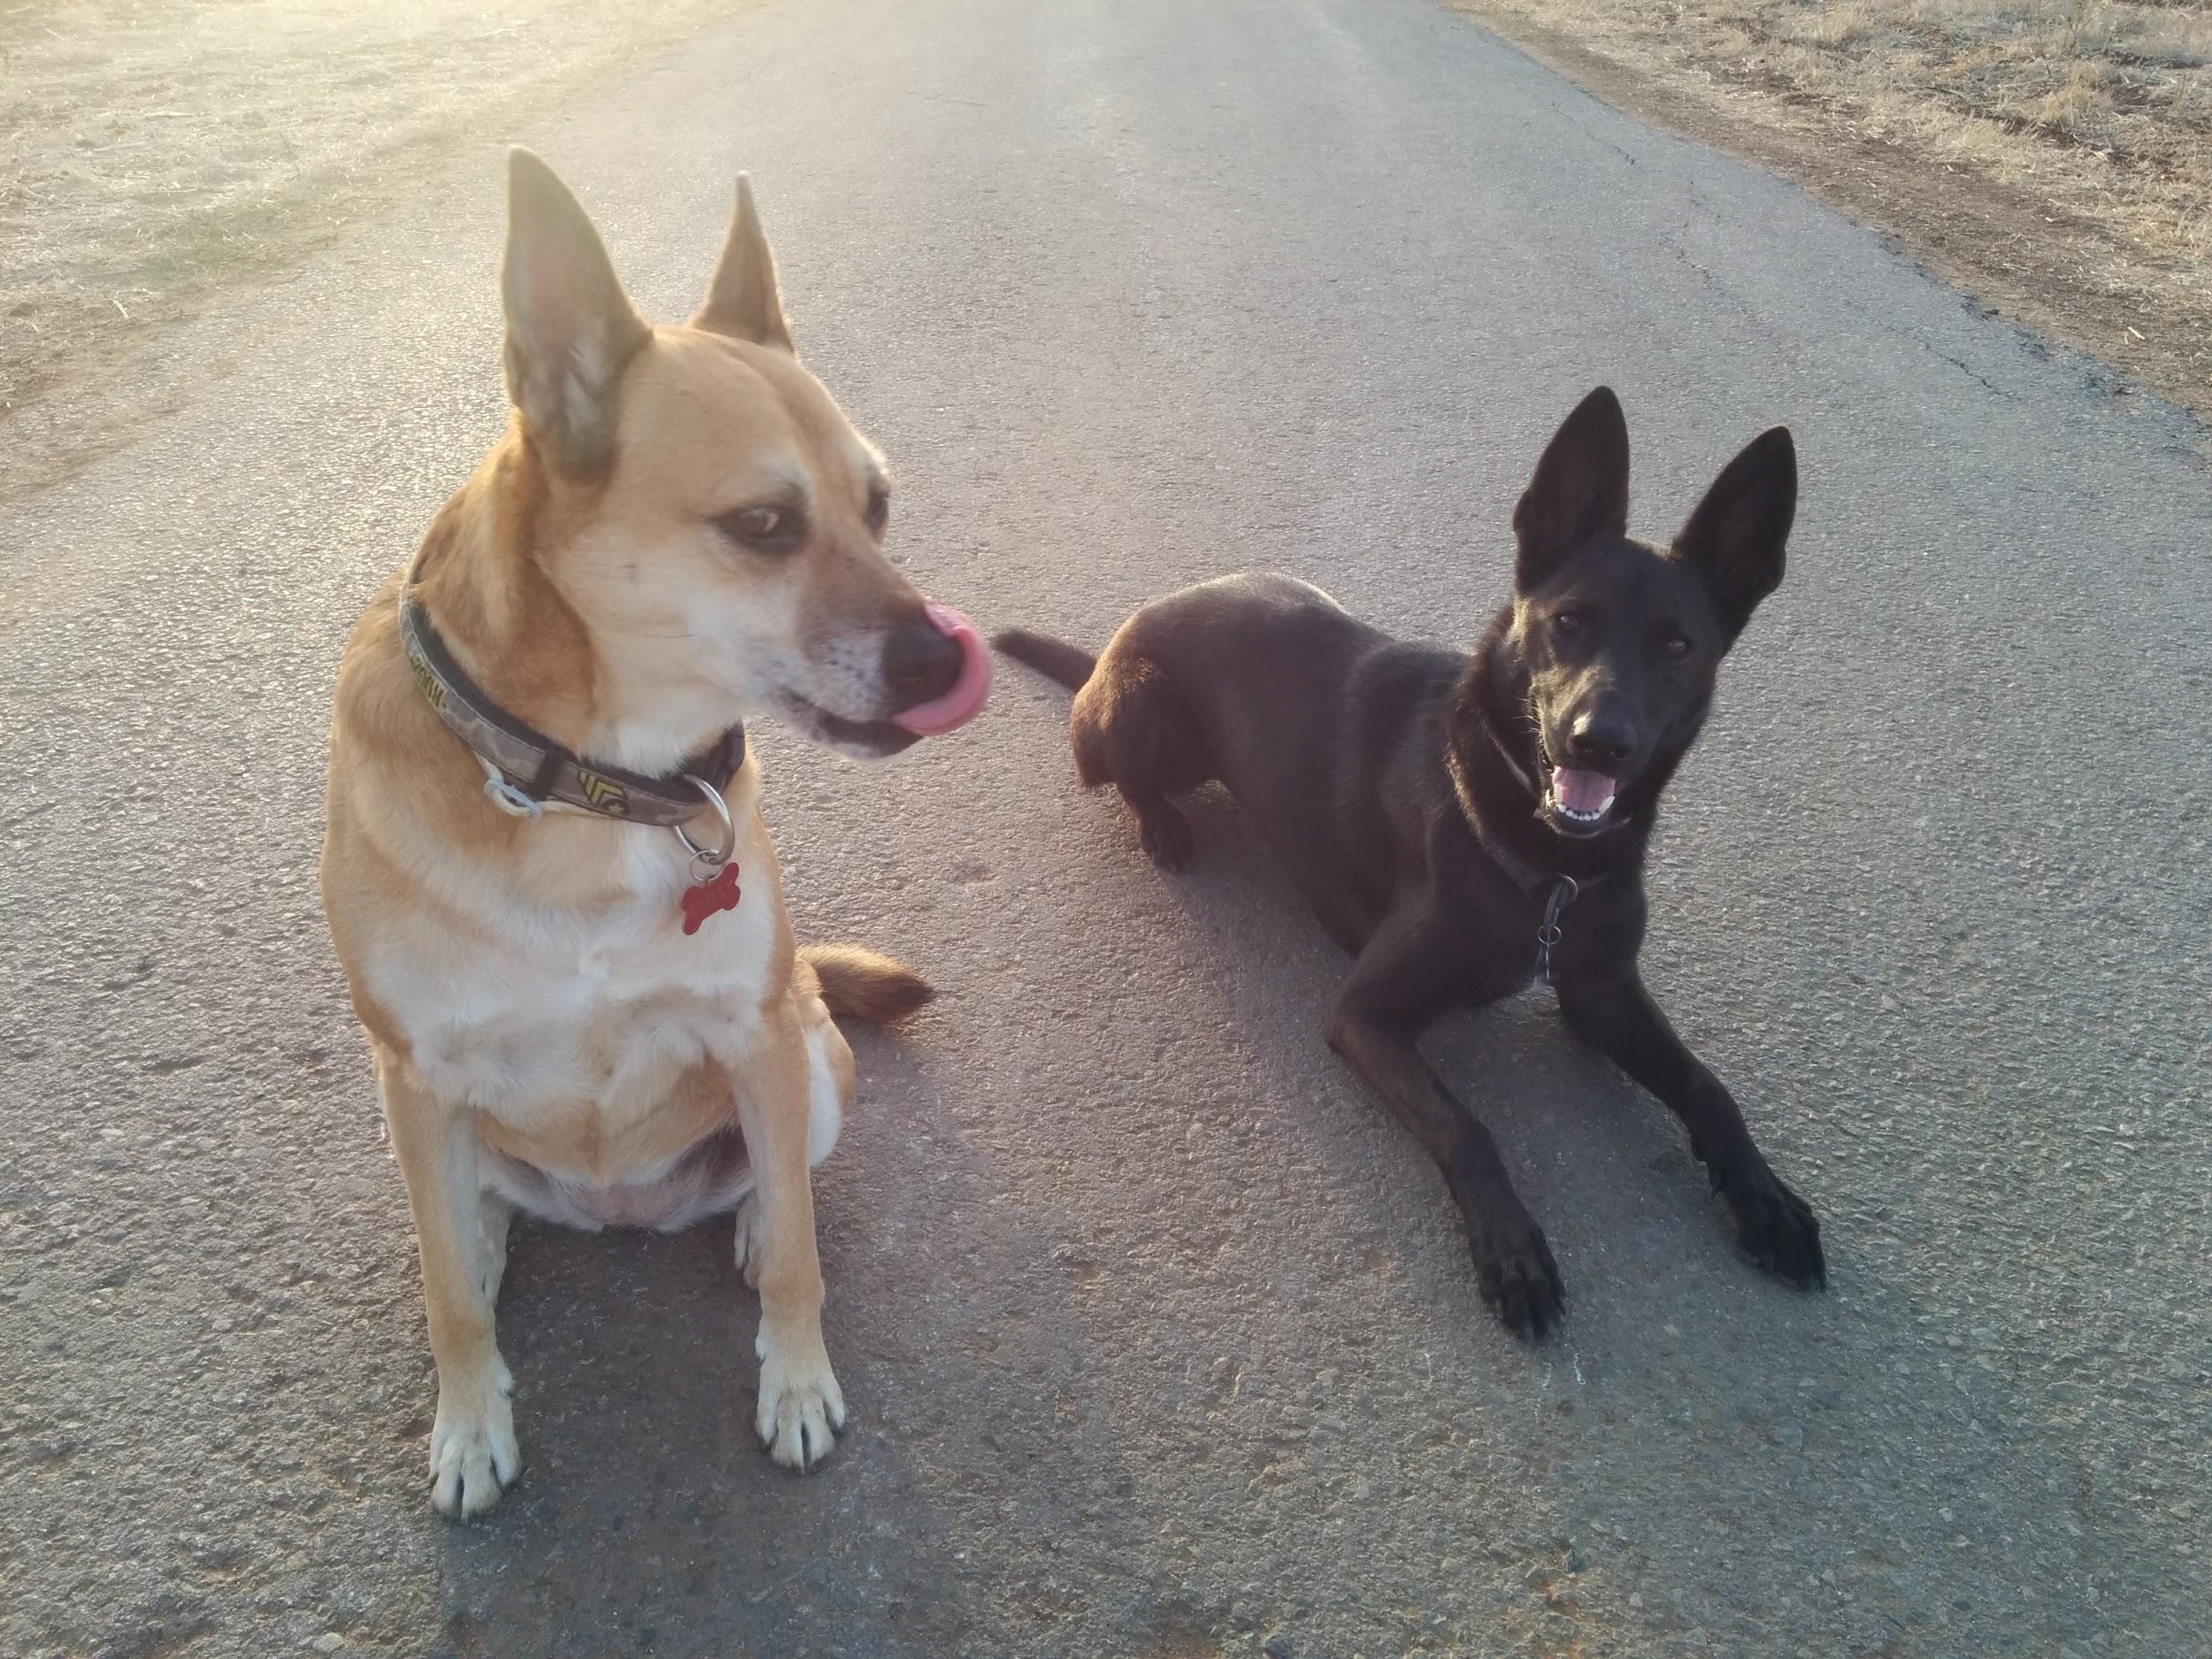
QUESTIONS?

